Slide 1
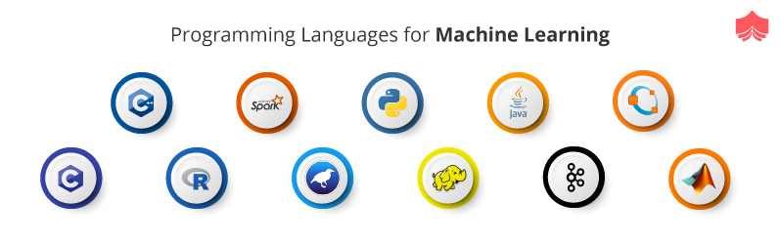
Yapay zeka için hangi programlama dillerini tercih etmeliyim?

Slide 2
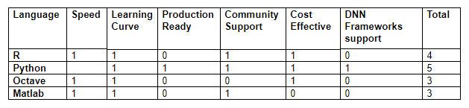

Slide 3
Python Libraries for Data Science
Many popular Python toolboxes/libraries:
NumPy
SciPy
Pandas
SciKit-Learn
Visualization libraries
matplotlib
Seaborn
and many more …
All these libraries are installed on the SCC

Slide 4

Python Libraries for Data Science
NumPy:
introduces objects for multidimensional arrays and matrices, as well as functions that allow to easily perform advanced mathematical and statistical operations on those objects
provides vectorization of mathematical operations on arrays and matrices which significantly improves the performance
many other python libraries are built on NumPy
Link: http://www.numpy.org/

Slide 5

Python Libraries for Data Science
SciPy:
collection of algorithms for linear algebra, differential equations, numerical integration, optimization, statistics and more
part of SciPy Stack
built on NumPy
Link: https://www.scipy.org/scipylib/

Slide 6
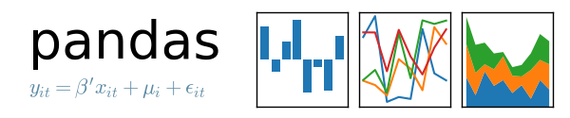
Python Libraries for Data Science
Pandas:
adds data structures and tools designed to work with table-like data (similar to Series and Data Frames in R)
provides tools for data manipulation: reshaping, merging, sorting, slicing, aggregation etc.
allows handling missing data
Link: http://pandas.pydata.org/

Slide 7

Python Libraries for Data Science
SciKit-Learn:
provides machine learning algorithms: classification, regression, clustering, model validation etc.
built on NumPy, SciPy and matplotlib
Link: http://scikit-learn.org/

Slide 8

Python Libraries for Data Science
matplotlib:
python 2D plotting library which produces publication quality figures in a variety of hardcopy formats
a set of functionalities similar to those of MATLAB
line plots, scatter plots, barcharts, histograms, pie charts etc.
relatively low-level; some effort needed to create advanced visualization
Link: https://matplotlib.org/

Slide 9
Python Libraries for Data Science
Seaborn:
based on matplotlib
provides high level interface for drawing attractive statistical graphics
Similar (in style) to the popular ggplot2 library in R
Link: https://seaborn.pydata.org/

Slide 10
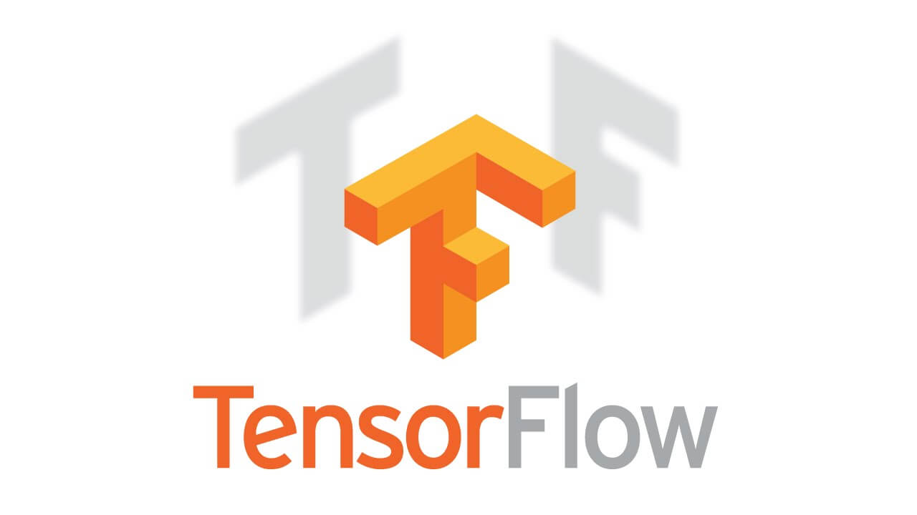
TensorFlow
TensorFlow, Google’ın açık kaynak kodlu makina öğrenmesi kütüphanesi ve özellikle derin öğrenme için kullanılıyor.

Slide 11
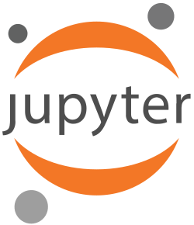
Jupyter
Diller için verdiğimiz cevaplar; R, Python veya Julia ve buna bağlı olarak geliştirme ortamları için R için R Studio, Python ve Julia için ise SublimeText ya da Atom.

Slide 12
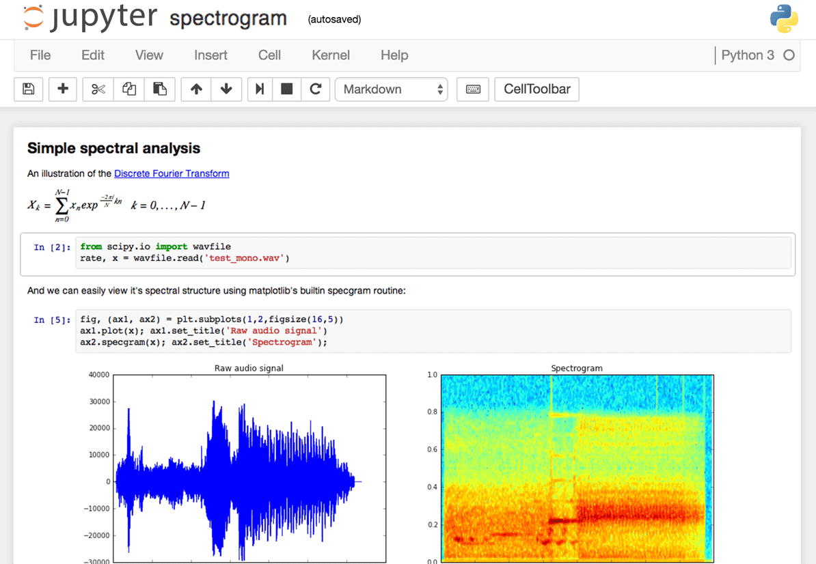

Slide 13

Anaconda
Anaconda, veri bilimi ve benzeri bilimsel uygulamalar için python kullanmak isteyenlere hazırlanmış tümleşik bir python dağıtımıdır. Veri bilimi, yapay zeka vb konularında sıkça kullanılan kütüphanelerin yanı sıra jupiter notebook ve spyder gibi araçları da barındırır.

Slide 14
